Slide 1

WELCOME

Slide 2

MD. Rajaul karim
Assistant Teacher (Computer)
Mongalbaria Kamil Madrasha
Pakundia, Kishoregonj
Mobile- 01714789802
Email- mdkrkarim@gmail.com

Slide 3

Class: Eight
Sub: English
First Paper

Slide 4


Aims and Objectives
After reading this lesson the students will be able to-------
Say what is letter?
Why we write letter?
Bad affect of smoking?
Answer given question?
Write a letter?

Slide 5
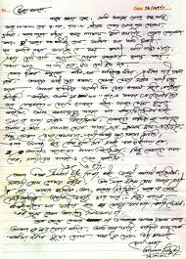



Slide 6

Unit: Three
Lesson: Five
A Letter

Slide 7
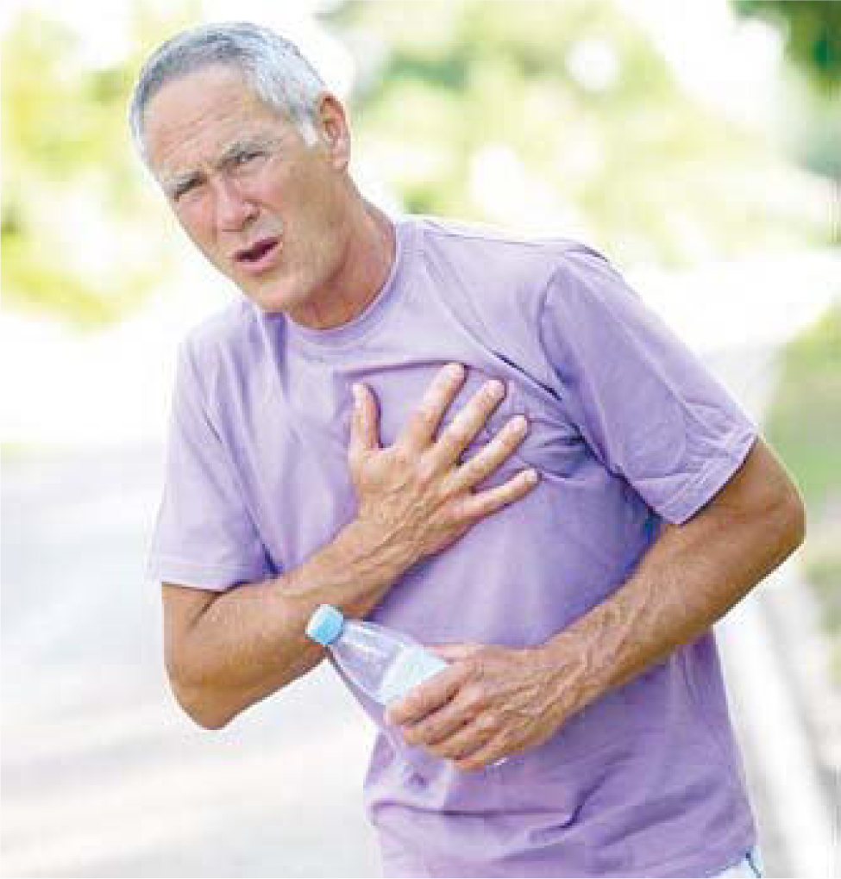
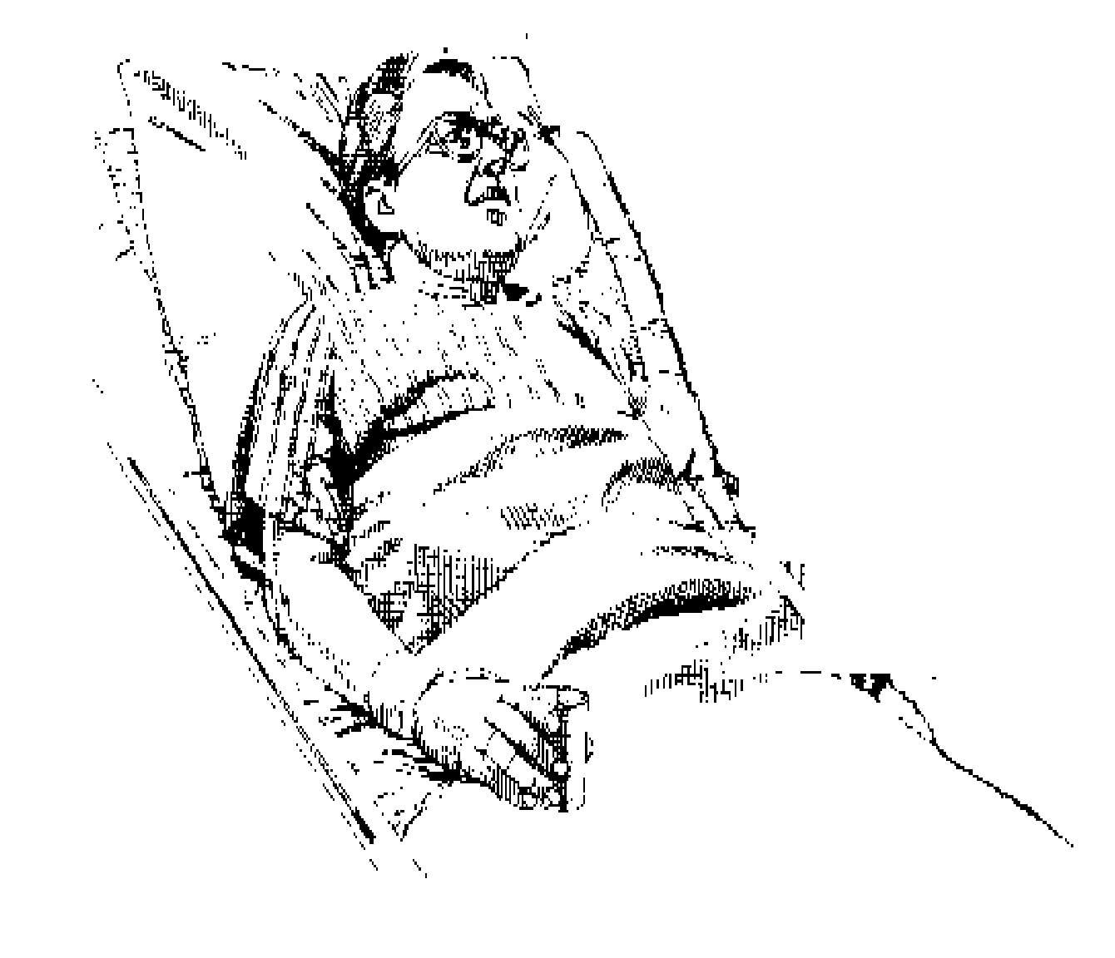
Look at the picture

Slide 8
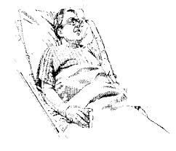
What happened to the man?
Read the passage silently

Slide 9
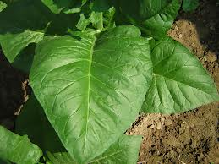
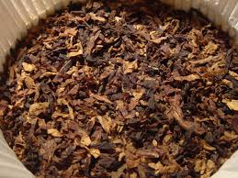
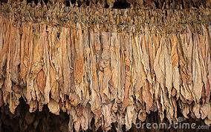
Nicotine an element of tobacco leaf

Slide 10
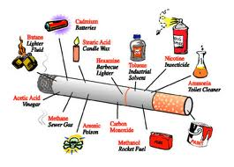
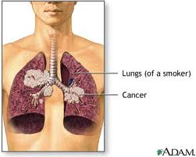
Lung of a smoker

Slide 11
How smoking attacks in lung of human body?

Slide 12
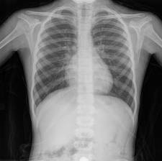
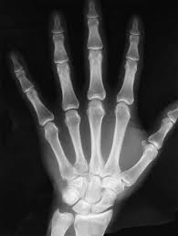
X-RAY

Slide 13
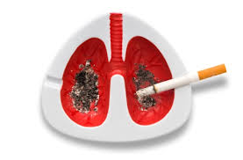
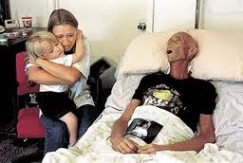
Bad affect of smoking

Slide 14

QUESTIONS
Who is the writer of the letter?
What causes lung cancer?
What does tobacco leaf contain?

Slide 15

HOMEWORK
Write a reply of given letter.

Slide 16

No more today.
Good bye.

